Slide 1

Salary Prediction Using Ensemble Learning
Presented by Hasratbeer kaur
Reg No 72412054
College Name CT University

Slide 2
Introduction
Salary prediction uses Machine Learning to estimate a person's salary based on their job, experience, and company details.
Pattern Recognition
Ensemble Learning
Interactive Dashboard
ML models uncover hidden salary patterns across roles, locations, and experience levels.
Combines multiple models to deliver more accurate and reliable salary estimates.
A user-friendly interface provides instant, actionable salary predictions for any profile.

Slide 3
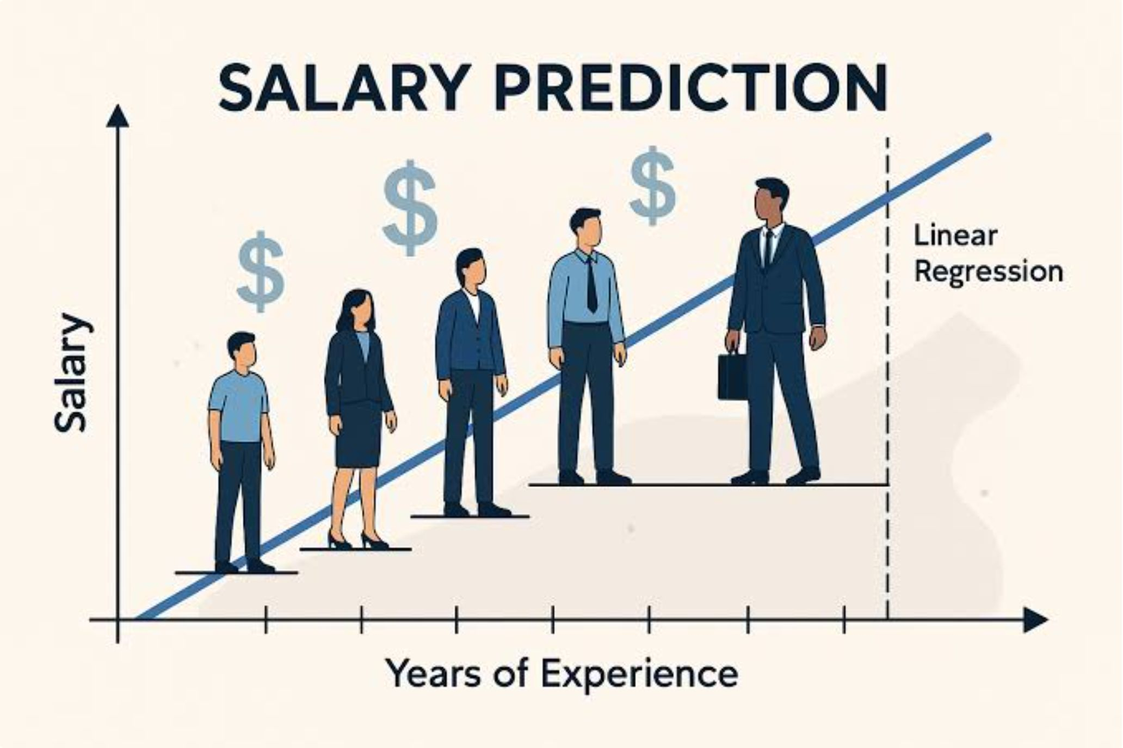
Problem Statement
Why Salary Prediction is Hard
Inconsistent Estimates
Manual salary estimation is time-consuming and prone to human bias.
Multi-Factor Complexity
A person's salary is affected by their experience, work location, company size, and job role together.
Single-Model Limitations
A single machine learning model may not always give accurate and consistent predictions.

Slide 4
Project Objectives
01
02
Predict Salaries with ML
Compare Multiple Algorithms
Build regression models trained on real-world DS salary data.
Evaluate Linear Regression, Decision Tree, Random Forest, and Gradient Boosting.
03
04
Improve Accuracy via Ensembling
Deploy an Interactive Dashboard
Combine best-performing models to reduce error and increase stability.
Deliver a clean UI for instant salary estimation by non-technical users.

Slide 5
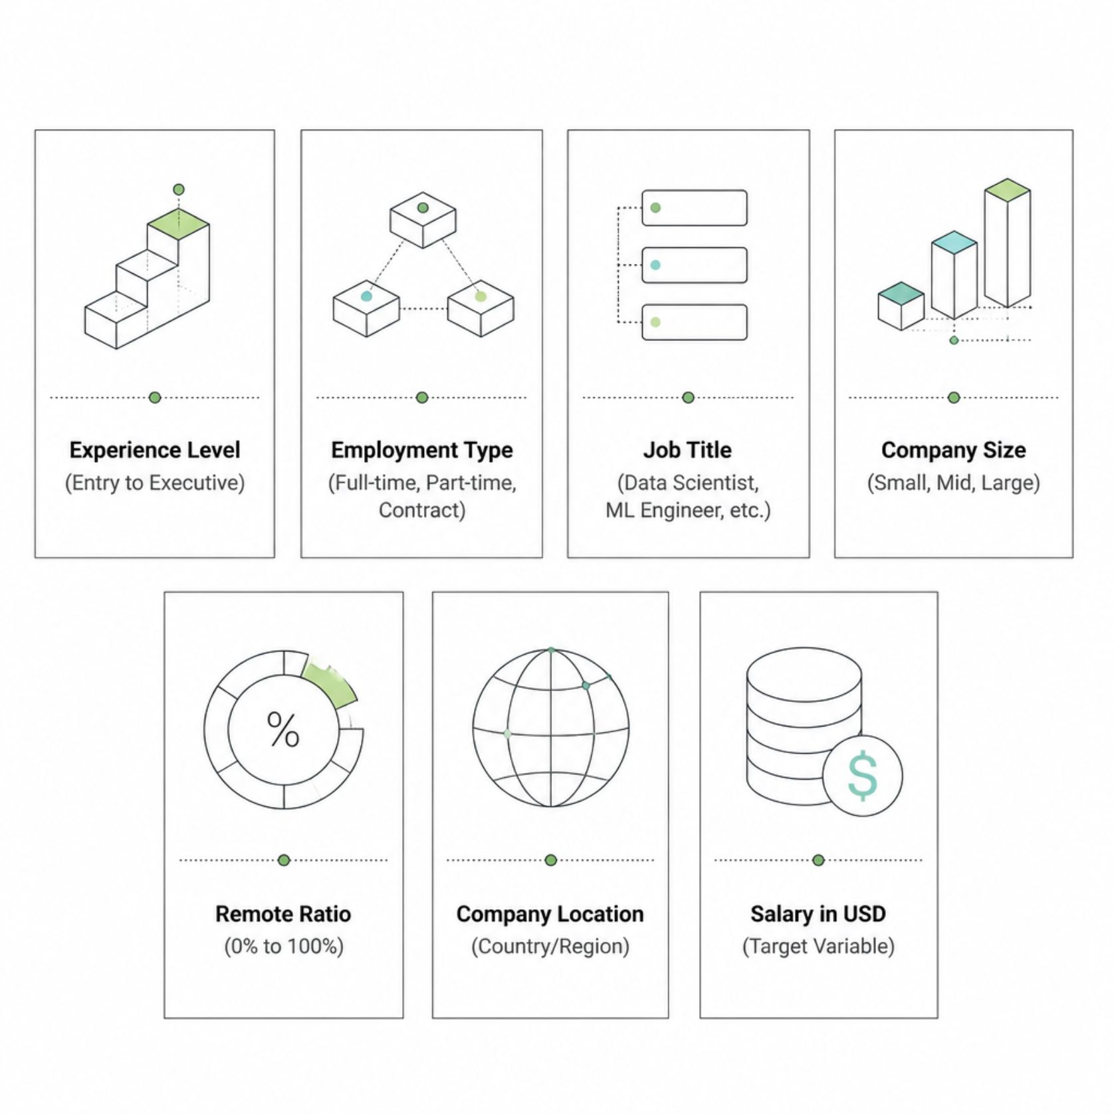
Dataset Overview
DS SALARIES DATASET
What the Data Captures
The dataset includes many data science jobs from different countries and contains the main factors that affect salary.
1. Text data was converted into numbers so the model could understand it.
2. Salary (USD) was used as the value to be predicted.
3. The dataset includes data from different countries and different types of companies.

Slide 6

Project Workflow
Collection
Cleaning
Encoding
Split
Training
A step-by-step process was followed from data collection to prediction.
This process helped improve data quality and build a reliable prediction system.

Slide 7
Data Preprocessing & ML Models
Preprocessing Steps
Models Compared
Removed irrelevant and redundant columns
Linear Regression
Decision Tree
Baseline model
Non-linear splits
One-hot encoded categorical features
Random Forest
Gradient Boosting
Selected high-impact attributes
Bagging ensemble
Boosting ensemble
Split data 80/20 for training and testing
Ensemble Model
Final predictor

Slide 8

Why Ensemble Learning?
Ensemble methods combine predictions from multiple models, reducing variance and bias to produce a more accurate and stable final output.
Model Combination
It combines the predictions of Random Forest, Gradient Boosting, and other models
Reduced Error
Averaging predictions cancels out individual model weaknesses.
Improved Stability
Less sensitive to outliers and noisy training data.
Best Accuracy
Consistently outperforms all individual models on test data.

Slide 9
Model Performance & Dashboard
Comparative Performance
Dashboard Features
Replace placeholder values (e.g., XX.XX or 0.00) with actual R² / MAE / RMSE scores from your notebook.
📋 Prediction Form
⚡ Instant Results
Input fields for experience, role, location, and more.
Salary output generated in milliseconds.
Model
Accuracy Trend
Ranking
Linear Regression
Baseline
5th
Decision Tree
Moderate
4th
📊 Interactive Charts
🧭 Easy Navigation
Random Forest
High
3rd
Clean UI designed for HR teams and job seekers.
Visual breakdown of salary factors and comparisons.
Gradient Boosting
Very High
2nd
Ensemble Model
Best
1st ✓

Slide 10

Results, Applications & Future Scope
Key Results
Future Scope
Ensemble model achieved the highest prediction accuracy
Dashboard delivers instant, consistent salary estimates
System generalizes well across diverse employee profiles
Real-Time Data Integration
Live salary feeds for up-to-date predictions.
Cloud Deployment
Scalable API access for enterprise use.
Mobile Application
On-the-go salary insights for job seekers.
Real-World Applications
HR teams can estimate fair salaries for new employees.
Companies can plan salary budgets more effectively.
Job seekers can understand the expected salary for a role.
AI Recommendations
Personalized career and upskilling suggestions.
Conclusion: This project demonstrates that Ensemble Learning significantly improves salary prediction accuracy, and an interactive dashboard makes ML accessible to real-world decision-makers.
THANK YOU

